Slide 1
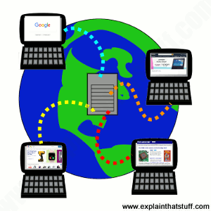
DESIGNING A WEBPAGE
JONNIFER C. MANDIGMA
SUBJECT PROFESSOR
Introduction to web design

Slide 2
Component in Designing the Webpage
Designing a webpage involves combining various components to create a visually appealing, user-friendly, and functional website. Here are some key components to consider when designing a webpage:

Slide 3
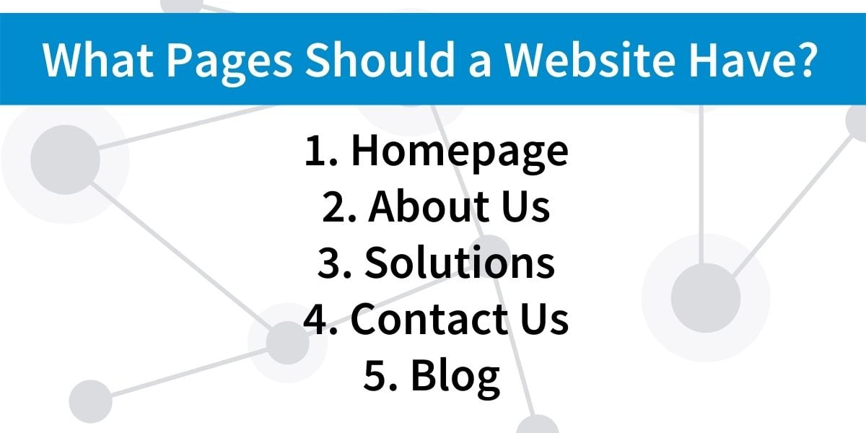
Content: The content of your webpage is the most crucial component. It includes text, images, videos, and other media that convey information to your audience. Content should be clear, concise, and relevant to your target audience.

Slide 4
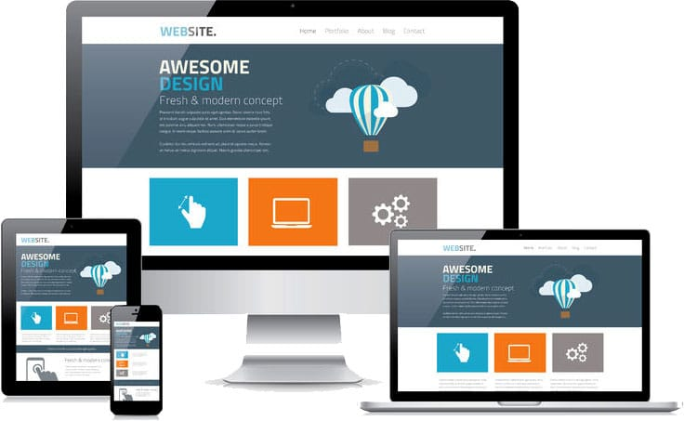
Layout: The layout defines the arrangement of content elements on the webpage. It includes the placement of text, images, navigation menus, and other design elements. A well-structured layout enhances the user experience.

Slide 5
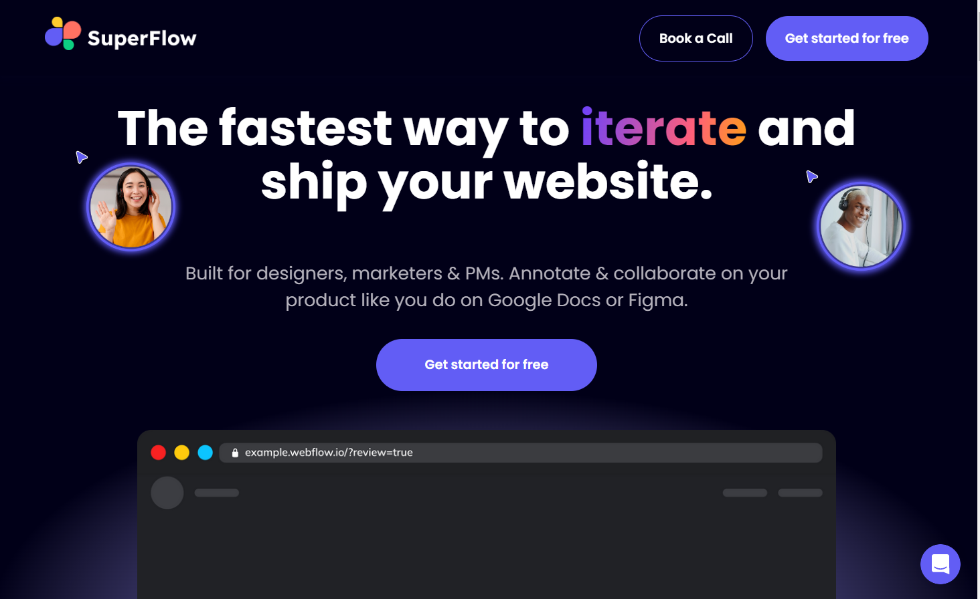
3.Typography: Choosing the right fonts, font sizes, and font styles (such as bold or italics) is crucial for readability and overall design. Consistency in typography helps create a professional look.

Slide 6

4. Color Scheme: The color scheme sets the tone for your webpage. It's important to select colors that match your brand and create a visually pleasing design. Consider the use of complementary colors, text-background contrast, and color psychology.

Slide 7
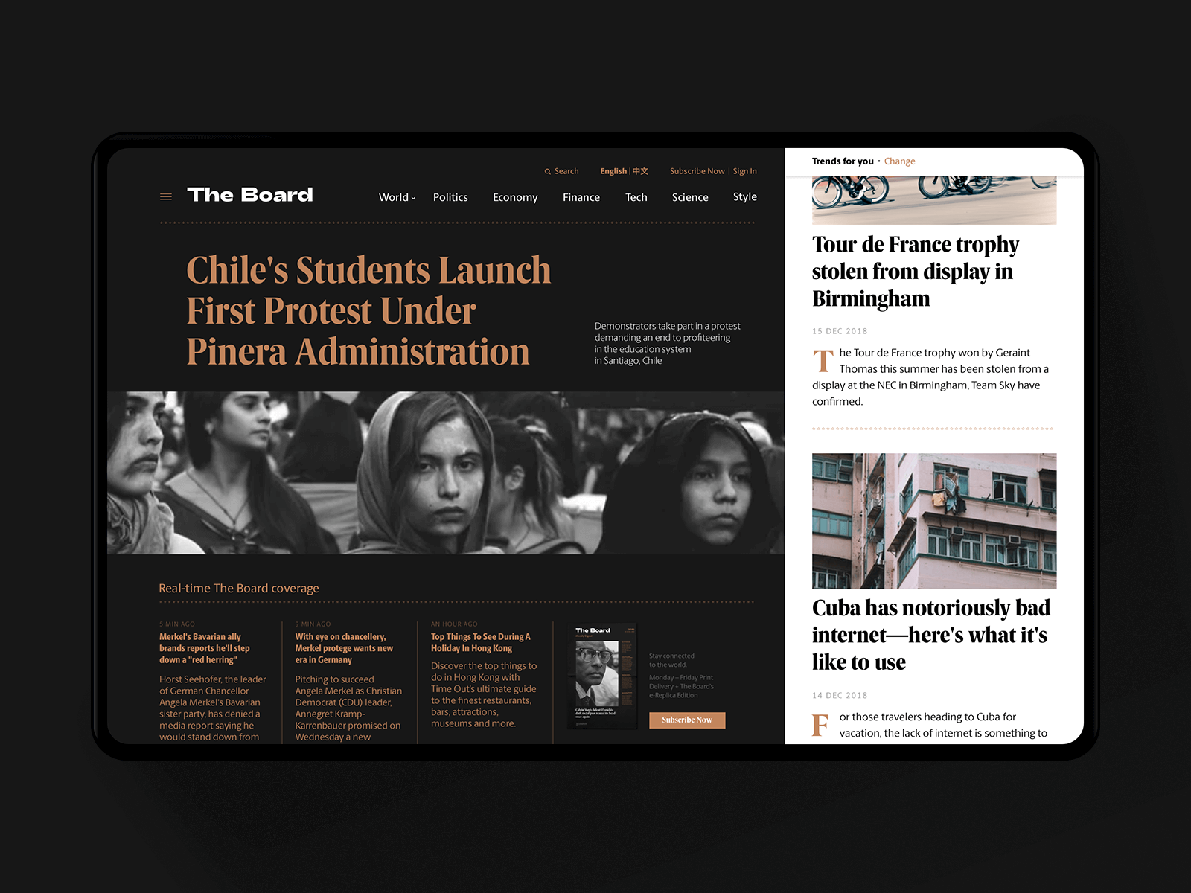
5. Images and Graphics: High-quality images and graphics can enhance the visual appeal of your webpage. Optimize images for web use to ensure fast loading times. Use graphics to illustrate concepts or data.

Slide 8
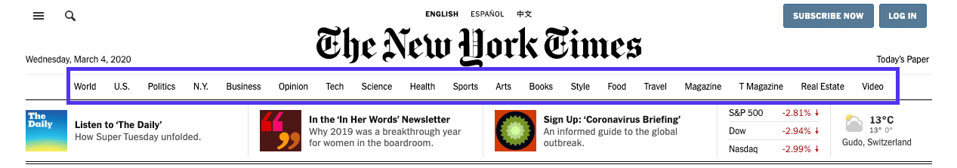
6. Navigation: Effective navigation menus and links make it easy for users to find their way around your site. Clear and intuitive navigation improves user experience and keeps visitors engaged.

Slide 9
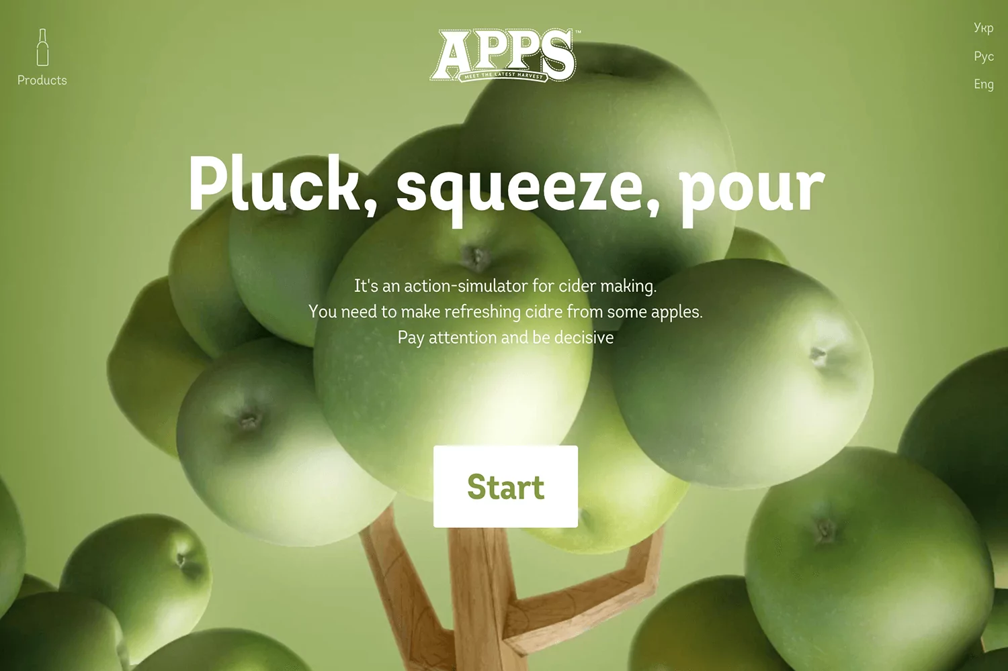
7. Forms and Interactivity: If your webpage includes forms or interactive elements, ensure that they are user-friendly, well-designed, and fully functional.

Slide 10
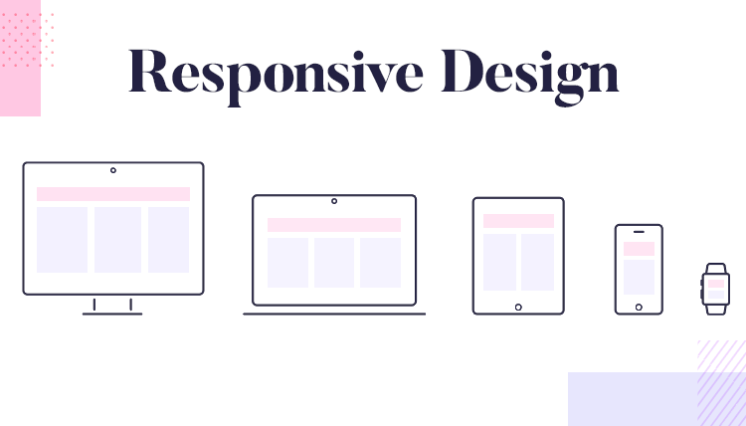
8. Responsive Design: With the increasing use of mobile devices, it's crucial to design webpages that are responsive. This means they adapt to different screen sizes and resolutions, ensuring a consistent user experience on various devices.

Slide 11
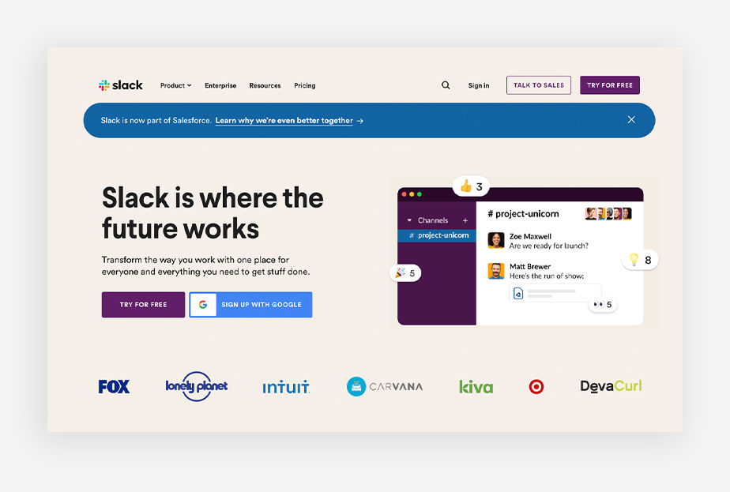
9. Call to Action (CTA): A clear and compelling CTA encourages users to take specific actions, such as signing up for a newsletter, making a purchase, or contacting you.

Slide 12

10. Accessibility: Ensure that your webpage is accessible to all users, including those with disabilities. This involves using alt text for images, providing keyboard navigation, and following accessibility guidelines (e.g., WCAG).

Slide 13
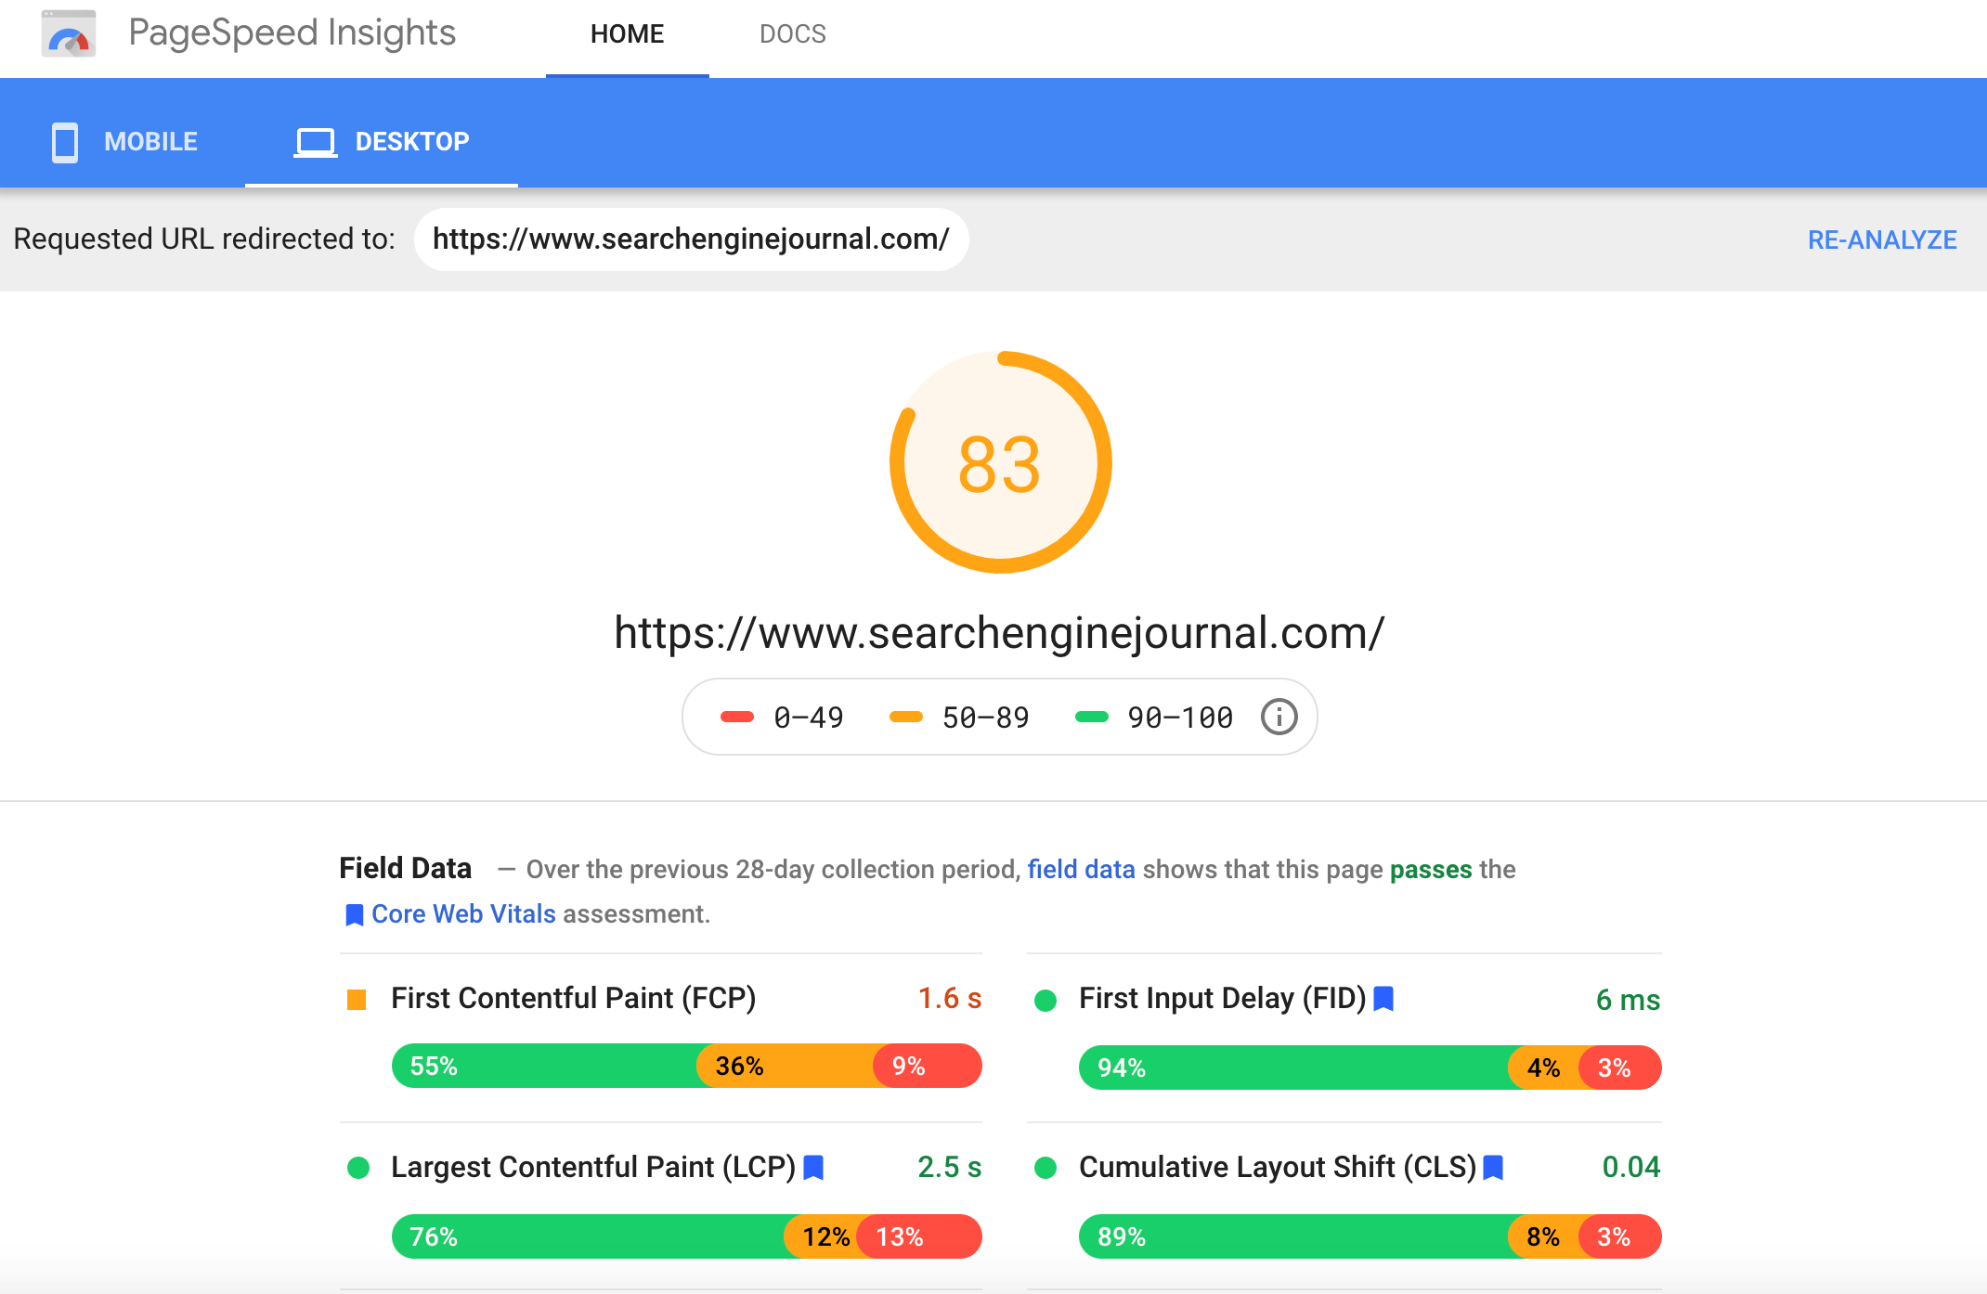
11. Loading Speed: A fast-loading webpage is essential for retaining visitors. Optimize images, use efficient coding practices, and consider content delivery networks (CDNs) for speed improvement.

Slide 14
12. SEO (Search Engine Optimization): Incorporate SEO best practices into your design to improve your website's visibility in search engines. This involves using relevant keywords, meta tags, and creating high-quality content.

Slide 15

12. Security: Implement security measures to protect user data and the website from threats. This includes using SSL certificates, secure forms, and regularly updating software.

Slide 16
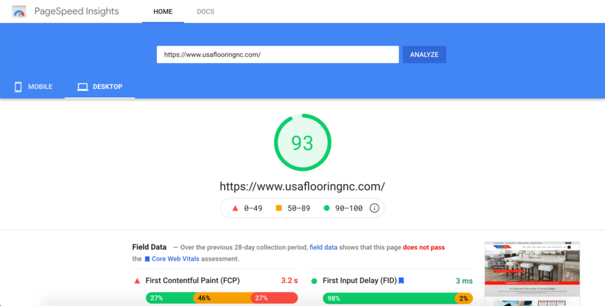
13. SEO (Search Engine Optimization): Incorporate SEO best practices into your design to improve your website's visibility in search engines. This involves using relevant keywords, meta tags, and creating high-quality content.

Slide 17
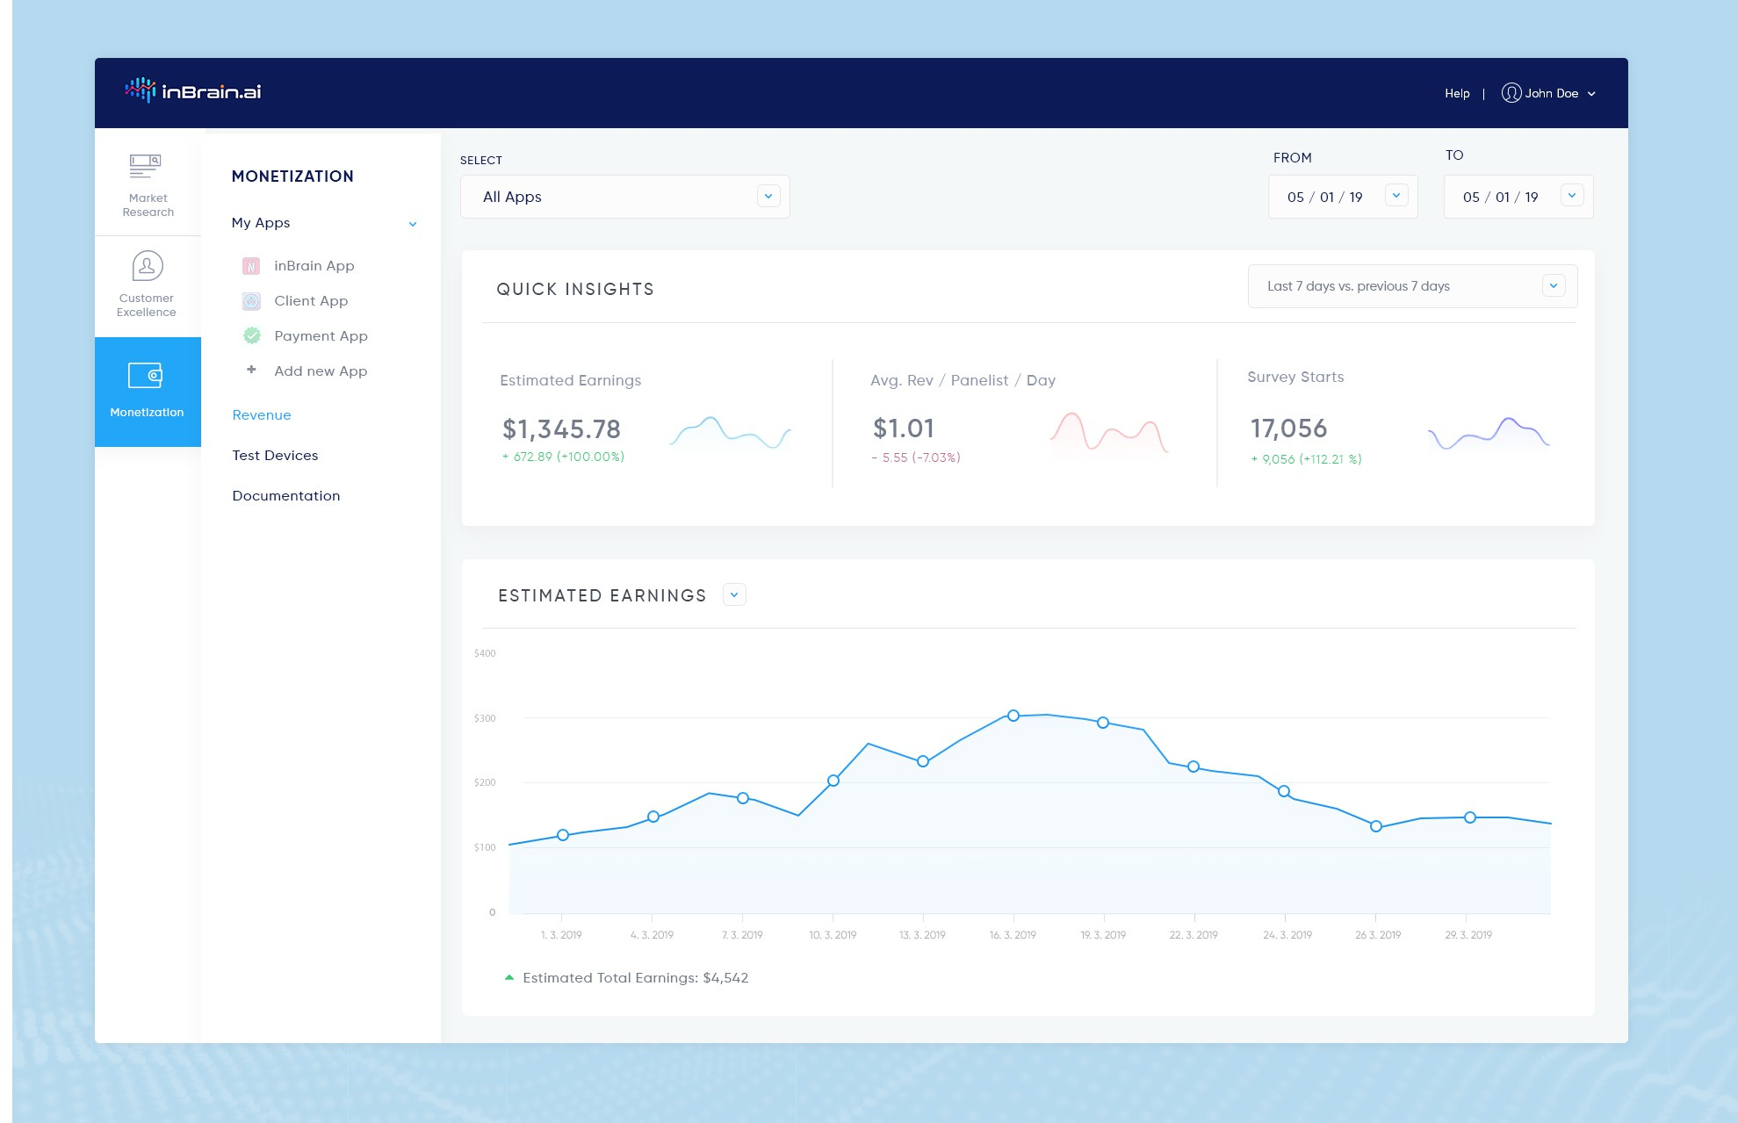
14. Analytics: Integrate web analytics tools (e.g., Google Analytics) to track visitor behavior, gather insights, and make data-driven improvements to your webpage.

Slide 18
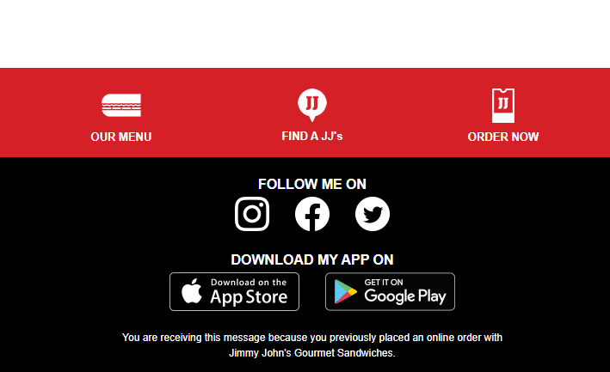
15. Social Media Integration: Make it easy for users to share content on social media platforms and incorporate social media feeds if relevant to your content.

Slide 19

16. Legal Compliance: Ensure that your webpage complies with relevant laws and regulations, such as privacy policies, GDPR, and copyright.

Slide 20
Designing documents for the Web requires a shift in the way you think about presenting your material. When you prepare a document for the Web, you concentrate on the content and structure of your information rather than on how the information will look on the page (fonts, etc.). In fact, what you put on the Web may look very different on different computers.

Slide 21
Planning your Web site
Planning your Web site ahead of time will help you stay organized and present your ideas to your audience in the best possible way. It is helpful to sketch your site on paper so that you have a visual image of how it will look. Each site begins with a home page that can lead to other pages, depending on how much information you want to convey. Some helpful considerations in planning your site are:

Slide 22
1. What is your purpose for doing a Web page? What type of information do you want to provide for people? How can you best organize that information so that people will be able to find it easily?
2. Who is your audience? How should you present your information to the audience you want to reach? Are they interested in quick facts? In getting instructions for registering for classes? In being entertained? Once you’ve identified your audience, you can decide what type of Web page will appeal to them. Is plain text appropriate or will your audience expect graphics, sound, and animation? Knowing your purpose and audience

Slide 23
Laboratory:
In your “index.html” file, between the </h1> and the </body> lines, type the
following as it appears here, including the blank line. To make your text file
easy to edit, press the ENTER key at the end of each line.
<p>
Creating HTML pages takes planning,
but the results are worthwhile.
Imagine the excitement of having your Web page seen by
people all over the world.
</p>

Slide 24
Exercise Continued
<p>
Keep your Web pages to a few screens each.
You can link information together, so don’t worry about
including everything at once.
</p>
<p>
Remember that readers do not always find
your home page first.
A link from somewhere else can lead them to
the middle of your information,
so try not to use words like
<br />
back<br />
forward<br />
previous<br />
next
<br />
to indicate navigation on your pages.
</p>

Slide 25
END OF LESSON
THANK YOU!!

